Slide 1
Optimization of Energy-efficient Cloud Radio Access Network (C-RAN) for 5G using Deep Reinforcement Learning (DRL)
Gabriel Kwame Freeman Index Number: PG7373923
Supervisors:
Prof. J. J. Kponyo

Slide 2
OUTLINES
Introduction and Research background
Problem statement and Objectives
Literature review
Methodology and Approach
Simulation and Results
References

Slide 3
Introduction and Research background
The rapid growth of wireless communication technologies and users demand for high-speed, low-latency services has driven the evolution of 5G networks.
To meet these requirements, 5G adopts dense deployments of small cells, massive MIMO, and centralized processing architectures like Cloud Radio Access Networks (C-RAN)
C-RAN decouples the baseband units (BBUs) from the remote radio heads (RRHs) and centralizes baseband processing, enabling more flexible and efficient resource management.
This architecture introduces new challenges, especially in energy efficiency. The continuous operation of RRHs and the demand for high speed data and video services couple with uneven services demand increase the energy consumption of the network hence the need for energy efficiency optimization.

Slide 4
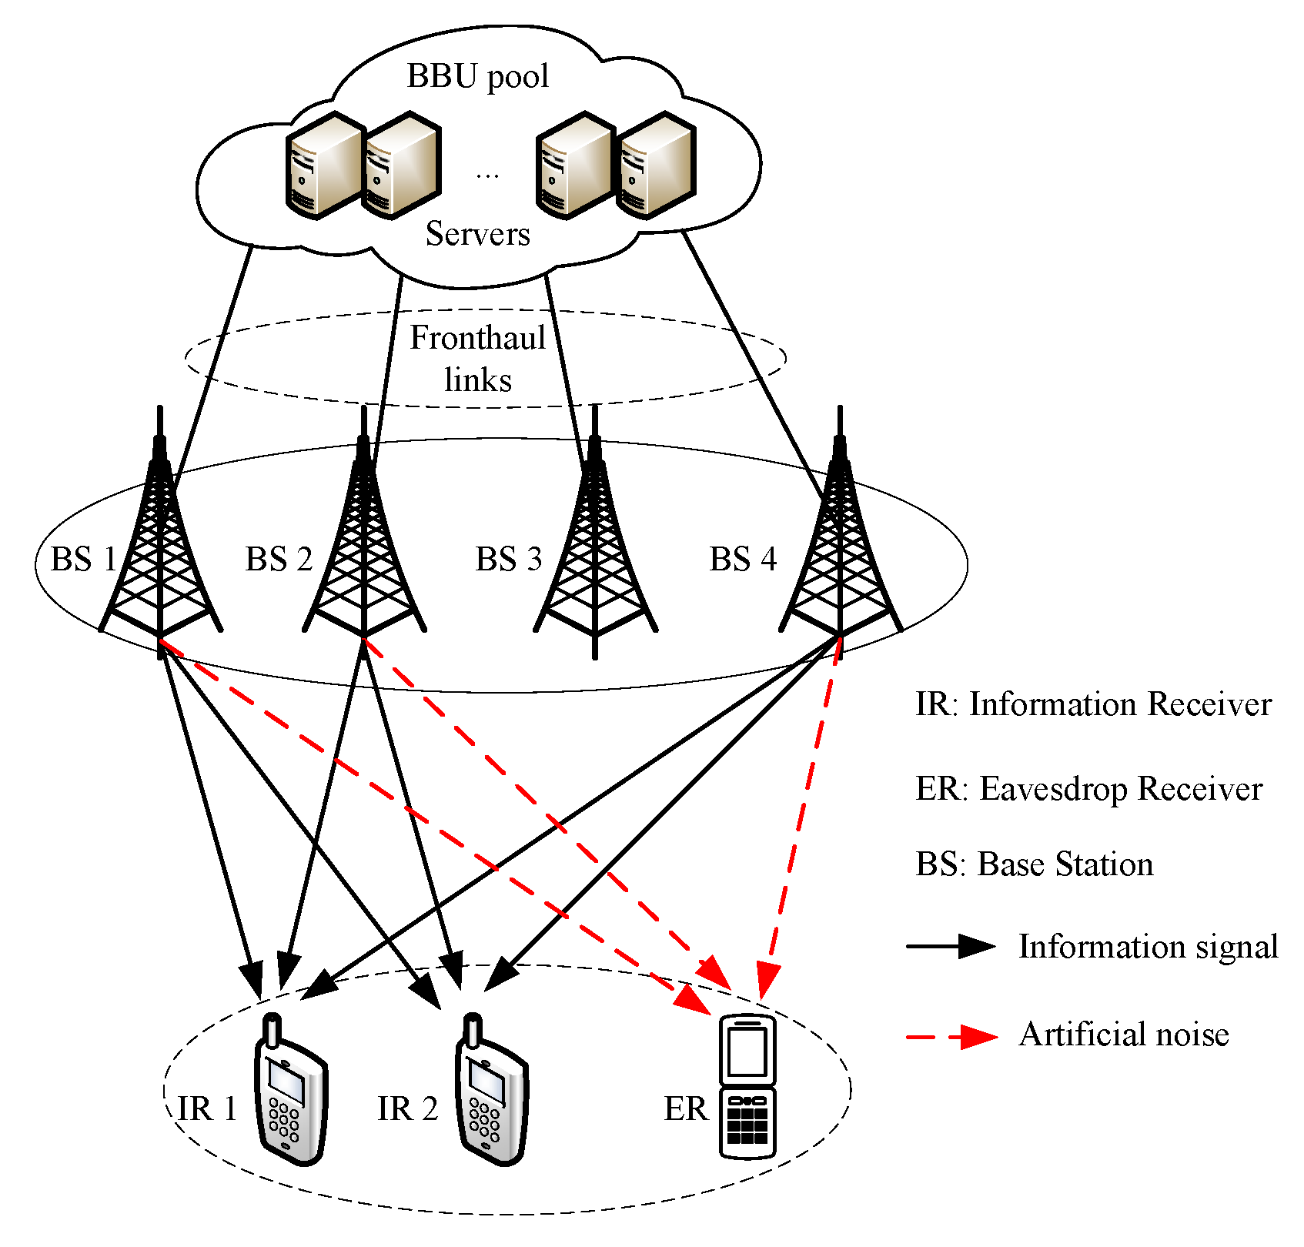
C-RAN Architecture

Slide 5
Problem statement and Objectives
Problem statement:
While C-RAN improves scalability and performance in 5G, it also leads to high energy consumption due to continuous RRHs activities and centralized processing. Also, the adaption to varying traffic loads and channel conditions.
Objectives:
To model the energy consumption and traffic behavior of a 5G C-RAN system.
To design a DRL agent capable of making dynamic decisions on RRH activation and resource allocation.

Slide 6
Literature Review
Optimization of Energy-Efficient Cloud Radio Access Networks for 5G using Artificial Neural Networks[1]
The power consumption is jointly formulated as power minimization beamforming and RRHs selection problem. An Artificial Neural Network (ANN) - based optimization model is used to optimize the active Remote Radio Heads (RRHs) numbers in remote network sites and the consumed power. The model considers various signal to interference plus noise ratios per client and power consumption models. Specifically, the model uses an adopted Bi-Section Group Sparse Beamforming (GSBF) optimization algorithm to reach near optimum solutions

Slide 7
Double Deep Q-Network-Based Energy-Efficient Resource Allocation in Cloud Radio Access Network[6]
In this paper, it aims to optimize the energy efficiency (EE) subject to the constraints on per-RRH transmission power and user data rates. It formulates the EE problem as a Markov decision process (MDP) and adopts deep reinforcement learning (DRL) technique to reap the cumulative EE rewards. In each time slot, it uses DQN algorithm to configure the status of RRHs prior to solving a power minimization problem for active RRHs.

Slide 8
A Deep Reinforcement Learning based Framework for Power-Efficient Resource Allocation in Cloud RANs[3]
The paper focuses on resource allocation improvement in cloud RANs to obtain the objective of minimizing power consumption and meeting demands of wireless users over a long operational period using a novel DRL-based framework. The paper applies a Deep Neural Network (DNN) to approximate the action-value function, and formally formulate the resource allocation problem (in each decision epoch) for a given set of active RRHs as a convex optimization problem.

Slide 9
Methodology and Approach
System Modeling - Model the 5G C-RAN environment including RRHs, users, channel states, and traffic load of the proposed
Algorithm Selection - Implement and train a DRL algorithm (using Deep Deterministic Policy Gradient(DDPG) for optimal policy learning.

Slide 10
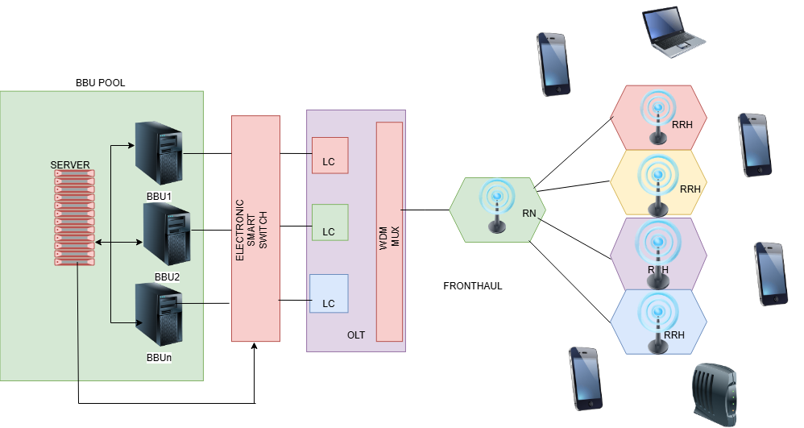
Proposed model

Slide 11
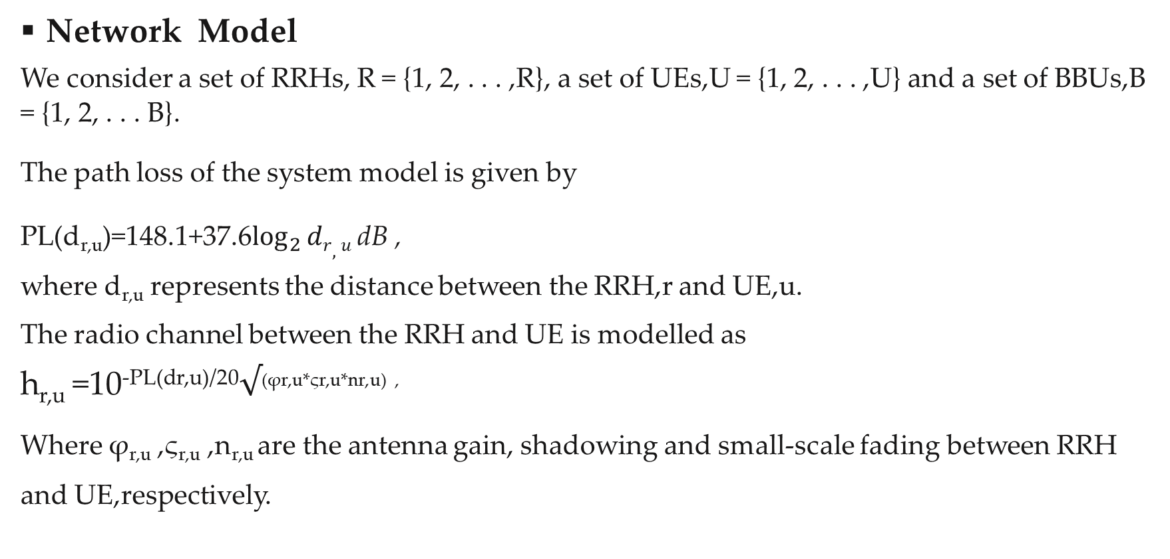
Network Model
We consider a set of RRHs, R = {1, 2, . . . ,R}, a set of UEs,U = {1, 2, . . . ,U} and a set of BBUs,B = {1, 2, . . . B}.
The path loss of the system model is given by
PL(d_{r,u})=148.1+37.6$\log_{2}{dr,u}$ dB , where d_{r,u} represents the distance between the RRH,r and UE,u.
The radio channel between the RRH and UE is modelled as
h_{r,u} =10^{-PL(dr,u)/20}$√$^{(φr,u*ςr,u*nr,u) ,}
Where φ_{r,u} ,ς_{r,u} ,n_{r,u} are the antenna gain, shadowing and small-scale fading between RRH and UE,respectively.

Slide 12
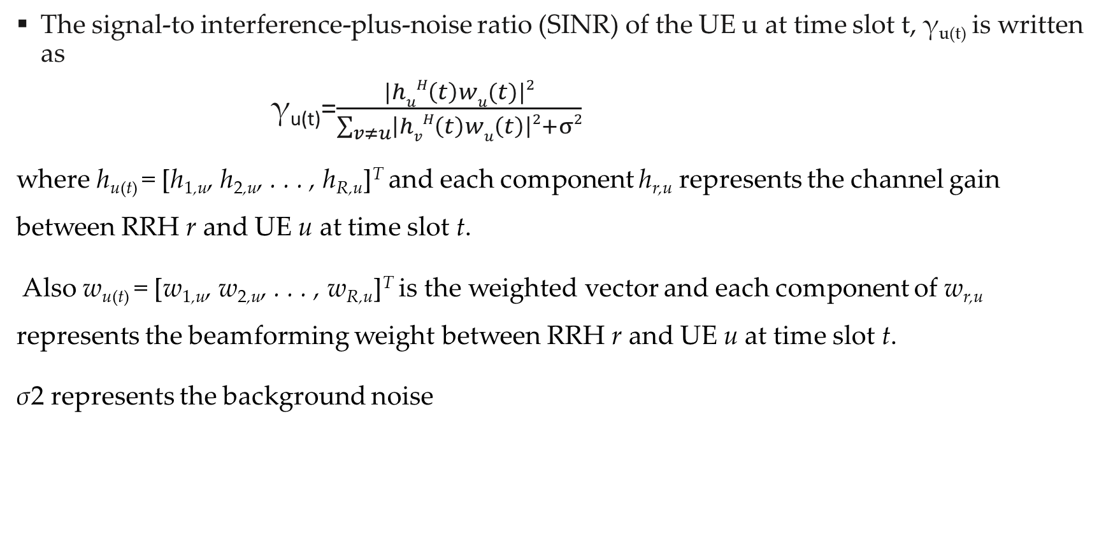
The signal-to interference-plus-noise ratio (SINR) of the UE u at time slot t, γ_{u(t)} is written as
γ_{u(t)}=$\frac{|huH\left(t\right)wu(t)|2}{\sum_{v≠u}{\left|hvH\left(t\right)wu\left(t\right)\right|2+σ2}}$
where h_{u(t)} = [h_{1,u}, h_{2,u}, . . . , h_{R,u}]^{T} and each component h_{r,u} represents the channel gain between RRH r and UE u at time slot t.
Also w_{u(t)} = [w_{1,u}, w_{2,u}, . . . , w_{R,u}]^{T} is the weighted vector and each component of w_{r,u} represents the beamforming weight between RRH r and UE u at time slot t.
σ2 represents the background noise

Slide 13

The Shannon capacity for UE u at time slot t, C_{u(t)} is calculated as
Cu(t)=B$\log_{2}{(1+}\frac{\text{γ}\text{u}\text{(}\text{t}\text{)}}{Ʈm}$)
where B is the transmission bandwidth and m denotes the realistic capacity gap depending on the modulation scheme

Slide 14
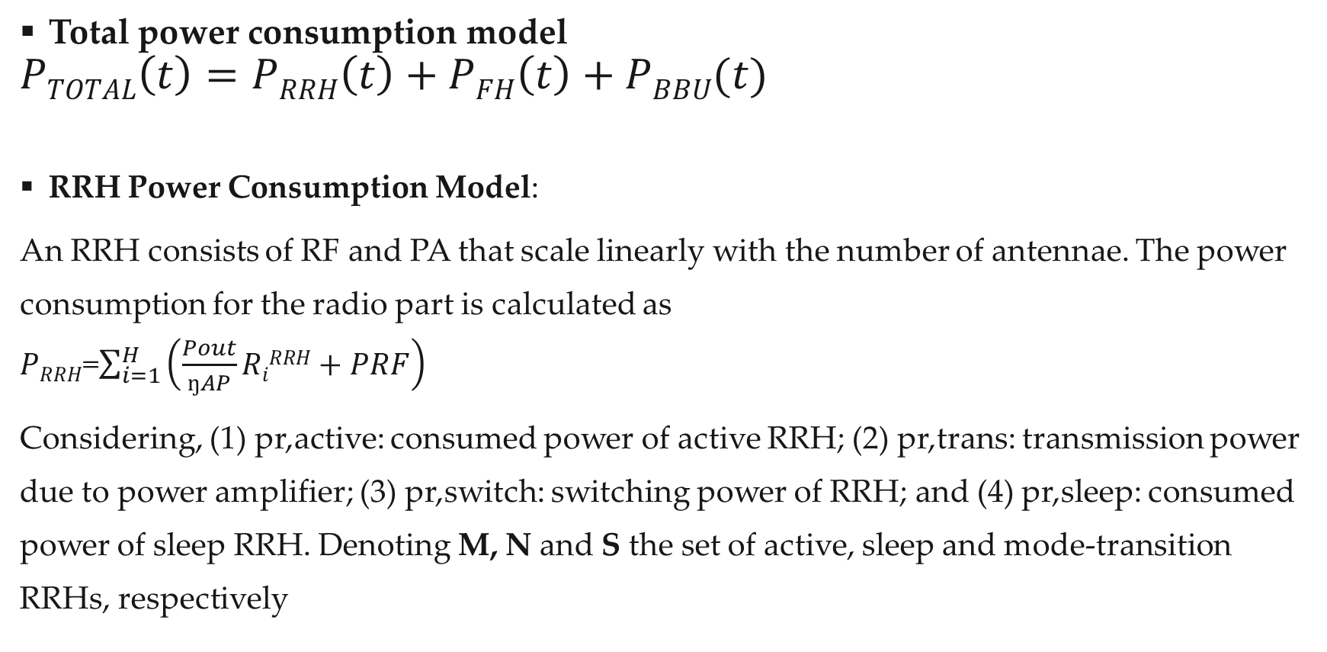
Total power consumption model
$$PTOTAL\left(t\right)=PRRH\left(t\right)+PFH\left(t\right)+PBBU(t)$$
RRH Power Consumption Model:
An RRH consists of RF and PA that scale linearly with the number of antennae. The power consumption for the radio part is calculated as
$PRRH$=$\sum_{i=1}^{H}{\left(\frac{Pout}{ŋAP}RiRRH+PRF\right)}$
Considering, (1) pr,active: consumed power of active RRH; (2) pr,trans: transmission power due to power amplifier; (3) pr,switch: switching power of RRH; and (4) pr,sleep: consumed power of sleep RRH. Denoting M, N and S the set of active, sleep and mode-transition RRHs, respectively

Slide 15
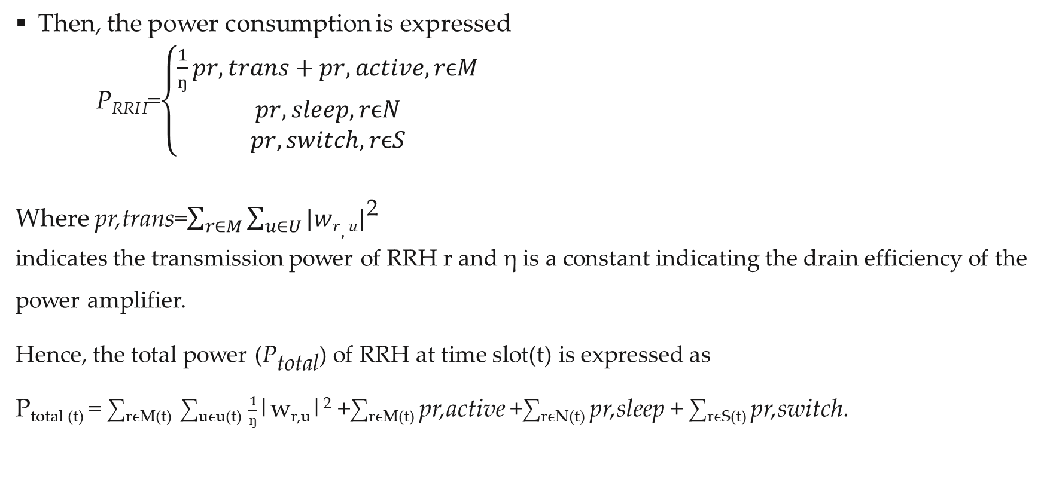
Then, the power consumption is expressed
P_{RRH}=$\left\{\begin{aligned}\frac{1}{ŋ}pr,trans+pr,active,rϵM \\ pr,sleep,rϵN \\ pr,switch,rϵS\end{aligned}\right.$
Where pr,trans=$\sum_{r∈M}{\sum_{u∈U}{|wr,u|}}$²
indicates the transmission power of RRH r and η is a constant indicating the drain efficiency of the power amplifier.
^{Hence, the total power (P}total) of RRH at time slot(t) is expressed as
P_{total (t)} = ∑_{rϵM(t)} ∑_{uϵu(t)} $\frac{1}{ŋ}$|w_{r,u}|² +∑_{rϵM(t)} pr,active +∑_{rϵN(t)} pr,sleep + ∑_{rϵS(t)} pr,switch.

Slide 16
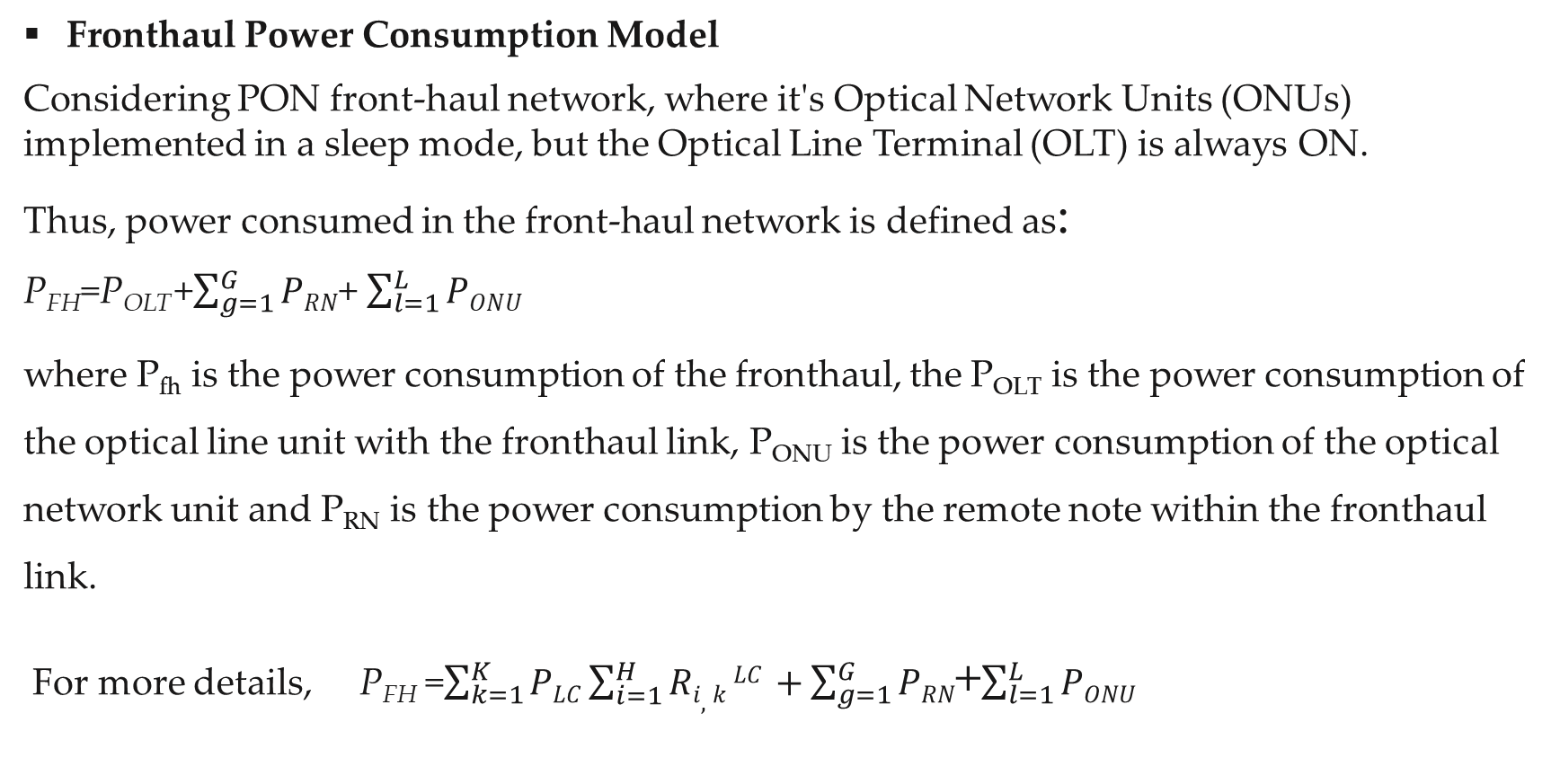
Fronthaul Power Consumption Model
Considering PON front-haul network, where it's Optical Network Units (ONUs) implemented in a sleep mode, but the Optical Line Terminal (OLT) is always ON.
Thus, power consumed in the front-haul network is defined as:
P_{FH}=P_{OLT} +$\sum_{g=1}^{G}{PRN}$+ $\sum_{l=1}^{L}{PONU}$
where P_{fh} is the power consumption of the fronthaul, the P_{OLT} is the power consumption of the optical line unit with the fronthaul link, P_{ONU} is the power consumption of the optical network unit and P_{RN} is the power consumption by the remote note within the fronthaul link.
For more details, P_{FH} =$\sum_{k=1}^{K}{PLC}\sum_{i=1}^{H}{Ri,k LC}$ $+\sum_{g=1}^{G}{PRN}$+$\sum_{l=1}^{L}{PONU}$

Slide 17

Where , $\sum_{i=1}^{H}{Ri,k LC}$ is the traffic loads of RRH_{i} served by the LCs.

Slide 18
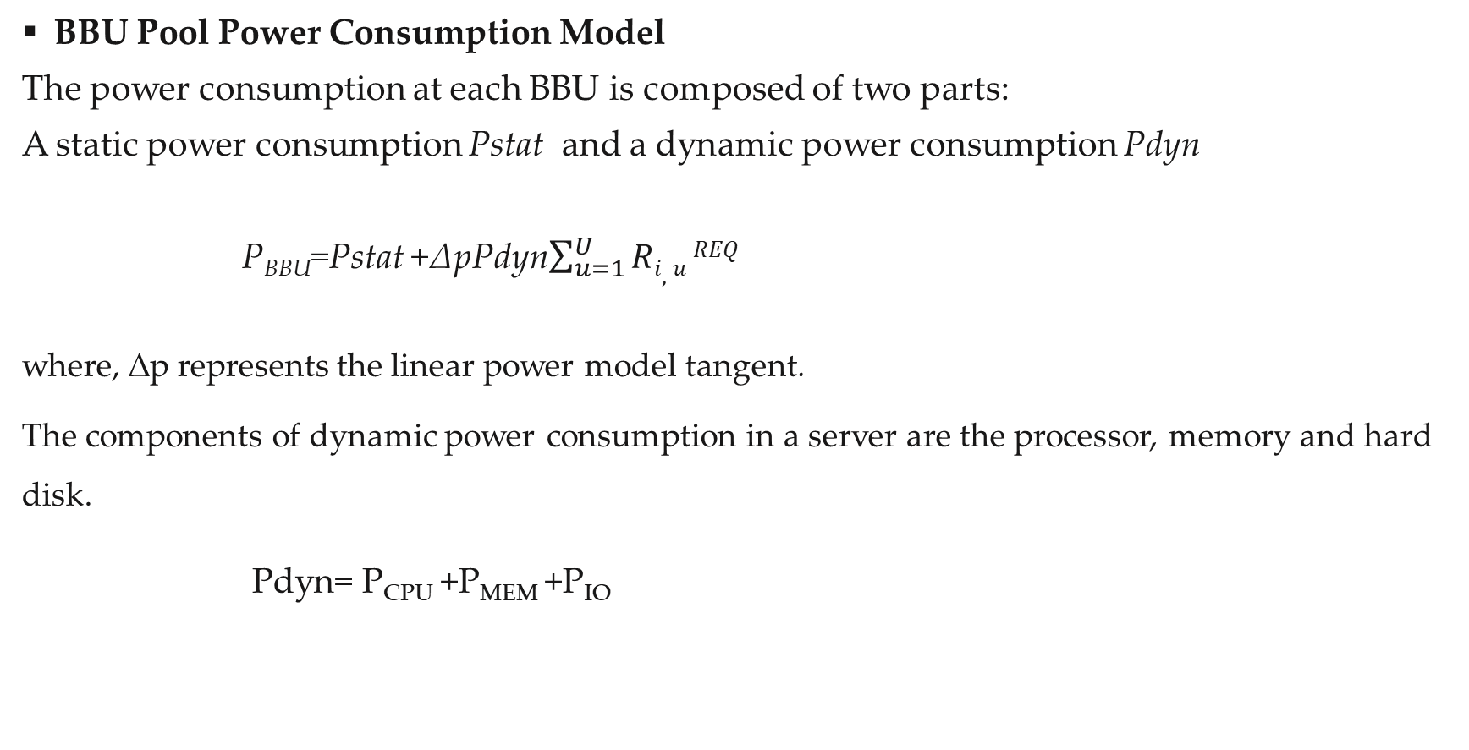
BBU Pool Power Consumption Model
The power consumption at each BBU is composed of two parts:
A static power consumption Pstat and a dynamic power consumption Pdyn
P_{BBU}=Pstat +∆pPdyn$\sum_{u=1}^{U}{Ri,u}REQ$
where, ∆p represents the linear power model tangent.
The components of dynamic power consumption in a server are the processor, memory and hard disk.
Pdyn= P_{CPU} +P_{MEM} +P_{IO}

Slide 19

P_{BBU}=P_{stat} +∆p(P_{CPU} +P_{MEM}+P_{IO}) $\sum_{u=1}^{U}{Ri,uREQ}$
Ppool=$\sum_{j=1}^{M}{(Pstat+∆p(PCPU+PMEM+PIO)}\sum_{u=1}^{U}{Ri,uREQ}$)

Slide 20
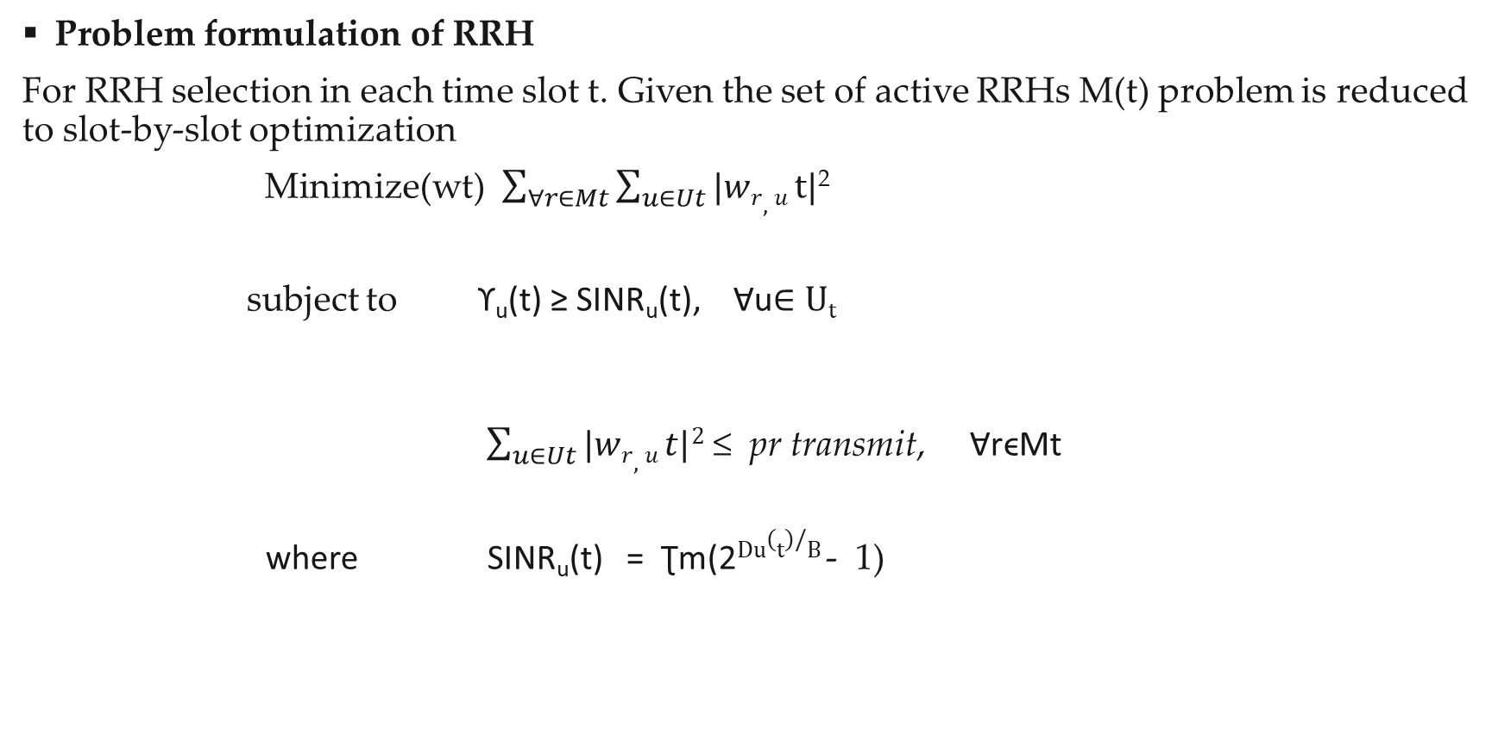
Problem formulation of RRH
For RRH selection in each time slot t. Given the set of active RRHs M(t) problem is reduced to slot-by-slot optimization
Minimize(wt) $\sum_{∀r∈Mt}{\sum_{u∈Ut}{|wr,u}}t|$²
subject to ϒ_{u}(t) ≥ SINR_{u}(t), Ɐu$∈Ut$
$\sum_{u∈Ut}{|wr,u t|2}$ ≤ pr transmit, ⱯrϵMt
where SINR_{u}(t) = Ʈm(2$Du(t)/B$- 1)

Slide 21

Problem formulation of the fronthaul(FH)
Minimizes $\sum_{k=1}^{K}{PLC ∗yk,j}\sum_{i=1}^{H}{Ri,k LC}$ $+\sum_{g=1}^{G}{PRN}∗sg$+$\sum_{l=1}^{L}{PONU} ∗$d_{l}
Subject to $\sum_{k=1}^{K}{yk,j }$≤ W_{k ,} ⱯjϵM
$\sum_{k=1}^{K}{yk,j }=1$, ⱯjϵM
y_{k,j} ϵ {0,1}, Ɐ jϵ M, k ϵ K
s_{g} ϵ {0,1} , ⱯgϵG
d_{l} ϵ {0,1}, ⱯlϵL

Slide 22

Problem formulation of the BBU Pool
Minimizes $\sum_{βi,j,u=1}^{M}{(ƮjPstat+∆p(PCPU+PMEM+PIO)}\sum_{j=1}^{H}{Rj,iBBU}$)
Subject to $\sum_{u=1}^{U}{R}$_{i,u}^{REQ}β_{i,j,u}$≤$G $∀ i∈H, j∈M$
β_{i ,j ,u} ϵ {0,1}
$\sum_{j=1}^{M}{\sum_{u=1}^{u}{β}}$_{I,j,u} =U $∀$iϵ H
$\sum_{i=1}^{H}{R}$_{j,i}^{BBU} ≤ MG $∀ j∈M$
$\sum_{u=1}^{U}{β}$_{I,j,u} =1 $∀i∈H,j∈M$
Ʈ_{j}=$\left\{\begin{aligned}0\sum_{i=1}^{H}{\sum_{u=1}^{U}{βi,j,u=0}} \\ 1 otherwise\end{aligned}\right.$

Slide 23
Simulation and Results
Simulation
In this work, Deep Deterministic Policy Gradient(DDPG) algorithm is considered to learn continuous control policies for energy management.
The BBU pool consists of 4 BBUs serving a variable number of 6 RRHs. Each BBU has 1 GOPS capacity. The detailed simulation parameters are shown in Table.
Moreover, this work uses MATLAB program to get the results.

Slide 24
P_noise_dBm | -102
P_active | 6.8
P_transmit | 1
P_sleep | 4.3
P_switch | 3
eta | 0.25
Antenna gain_dBi | 9
Shadowing_dB | 8
Cap_gap | 1
Ntx | 2
P_RF | 0.1
epsilon | 0.05
gamma | 0.99
tau_soft | 0.005
Lr_actor,lr_critic | 1e-4, 1e-3
Number of RRHs | 6
Number of BBUs | 4
Number of Users | 20
P_stat | 100
delta_P | 0.5
P_cpu | 50
P_mem | 10
P_io | 5
P_olt | 50
P_rn | 1
P_onu_active | 2
P_lc | 10
replay _size | 10000
batch _size | 64
Max_epochs | 1000

Slide 25
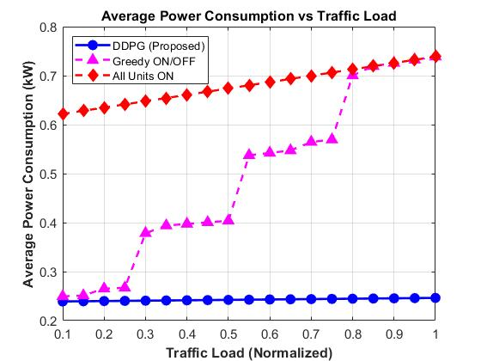
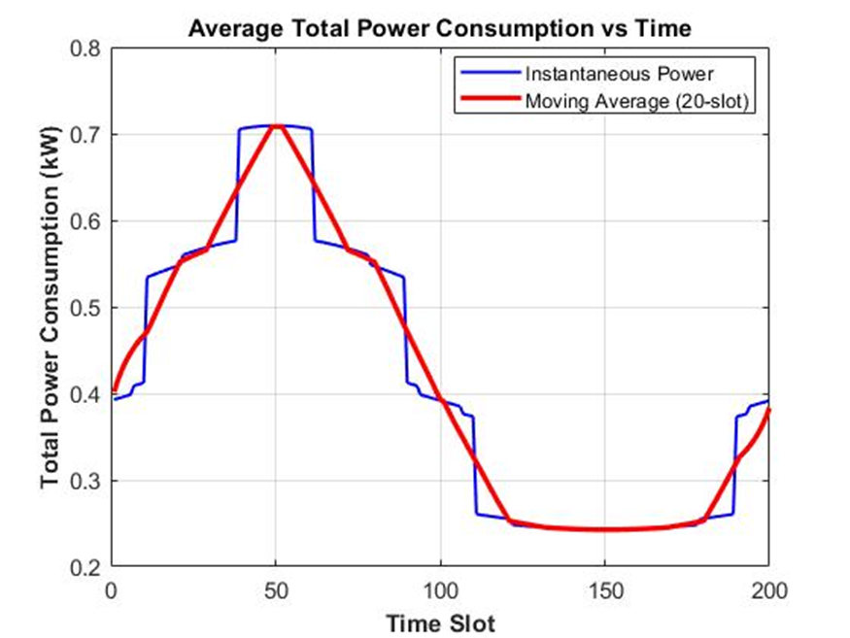
Results

Slide 26
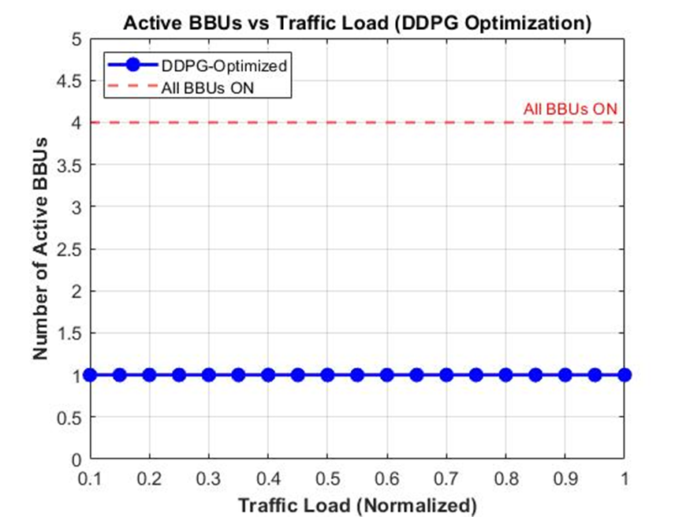
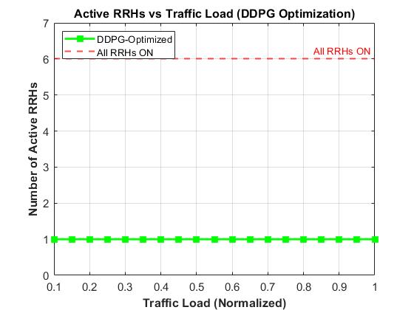

Slide 27
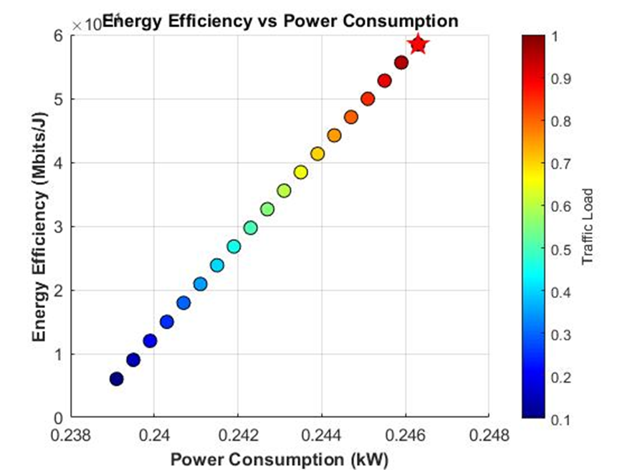

Slide 28
References
1. Maha Fathy, Mohamed Salah Abood, Mustafa Maad Hamdi. “Optimization of Energy-Efficient Cloud Radio Access Networks for 5G using Neural Networks”IEEE International conference on Intelligent Technology,System and services for Internet of Everything(ITSS-IoE),2021.
2. R. Zamblé, L. Kra, M. Koffi, R. Gbégbé, B. T. Gooré and O. Asseu. “Power consumption optimization in 5G radio access networks, based on a call admission control algorithm" Far East Journal of Electronics and Communications, Pushpa Publishing House, Allahabad, India. Vol.18, NO.4,Pages 507-520,2018.
3. Zhiyuan Xu, Yanzhi Wang, Jian Tang, Jing Wang, and Mustafa Cenk Gursoy. “A Deep Reinforcement Learning based Framework for Power-Efficient Resource Allocation in Cloud RANs” IEEE ICC Next Generation Networking and Internet Symposium,2017.
4. Hyebin Park and Yujin Lim. “Reinforcement Learning for Energy Optimization with 5G Communications in Vehicular Social Networks” www.mdpi.com/journal/sensors,2020.

Slide 29
K. Vinoth, S. Purushothaman, R. Baskar, C. Gomathi “Optimal Energy Efficiency for 5G Wireless Communications” International Journal of Research in Engineering, Science and Management Volume-1, Issue-12,2018
Amjad Iqbal,Mau-leau Tham,Yoong Choon Chang “Double Deep Q-Network-Based Energy-Efficient Resource Allocation in Cloud Radio Access Network” IEEE Access 10.1109/ACCESS.2021.3054909.
D. Mishra, P. Amogh, A. Ramamurthy, A. A. Franklin, and B. R. Tamma, “Load-aware dynamic rrh assignment in cloud radio access networks,” in Wireless Communications and Networking Conference (WCNC), 2016 IEEE. IEEE, 2016, pp. 1–6.
C. Lange and A. Gladisch, “On the energy consumption of ftth access networks,” in Optical Fiber Communication-incudes post deadline papers, 2009. OFC 2009. Conference on. IEEE, 2009, pp. 1–3

Slide 30
THANK YOU

